Slide 1
Flame Extinction in Isolated Compartment Fires
Presentation prepared by: Ryan Falkenstein-Smith
1

Slide 2
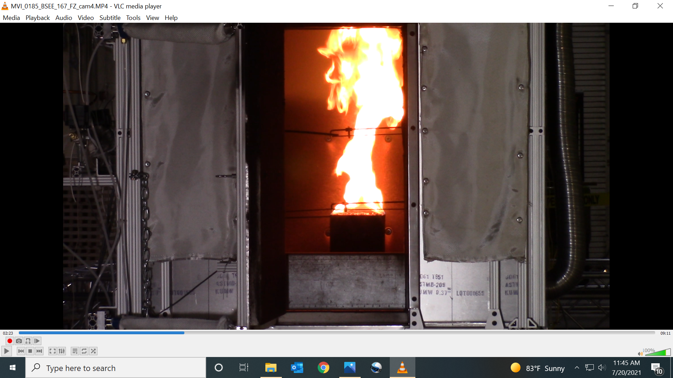
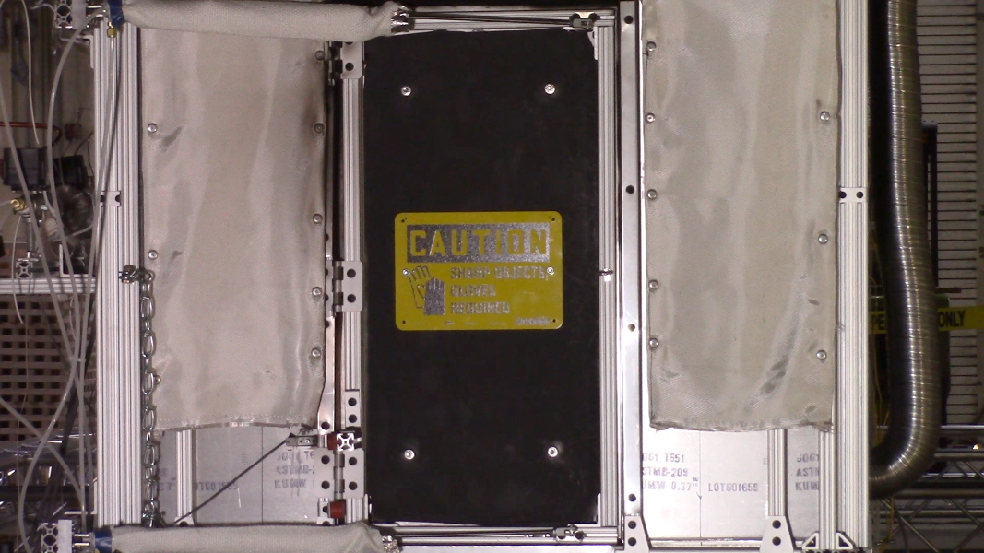
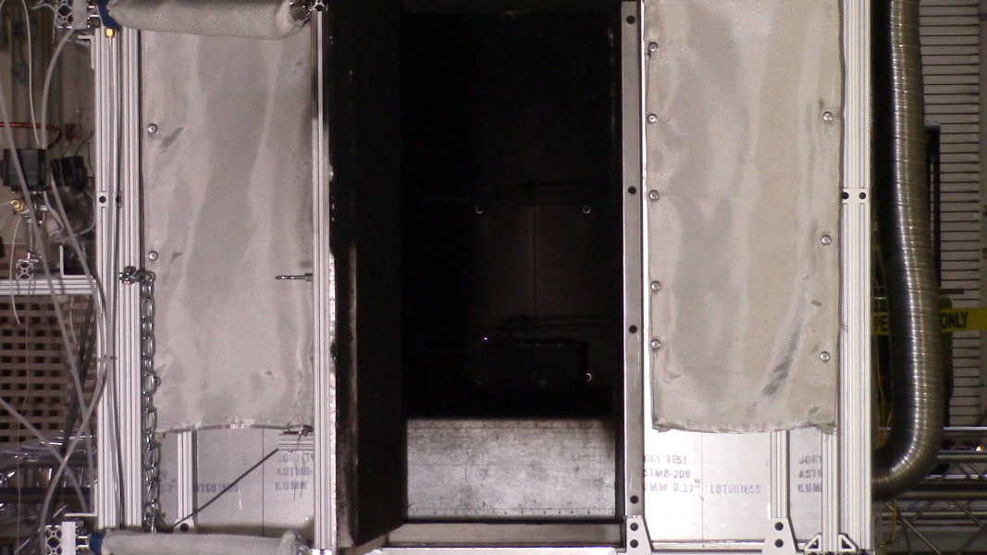
General description of experiments
Fire
Ignited (t=0)
Compartment door
closed (t=60)
Compartment door
opened (t=FFT+30)
Configuration variables
Fuel
Fire size
Fuel flow time
Fuel | Fire Size (kW) | Fuel flow time [FFT] (s)
Methane | 37.5 + 1.0 | 240, 270, 285, 300
Propane | 16.7 + 1.0 | 270, 300, 315, 330
 | 25.0 + 1.0 | 240, 270, 285, 300
Conditions are based on when borescope was utilized in the experimental setup
2

Slide 3
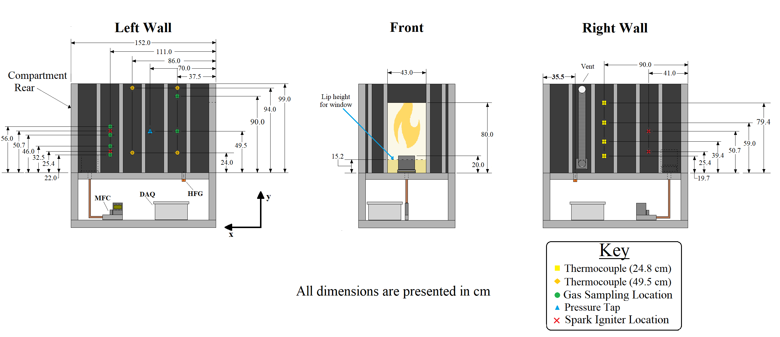
Experimental Setup
In experiments where a borescope was utilized, gas sampling positions were located towards the front of the compartment
3

Slide 4
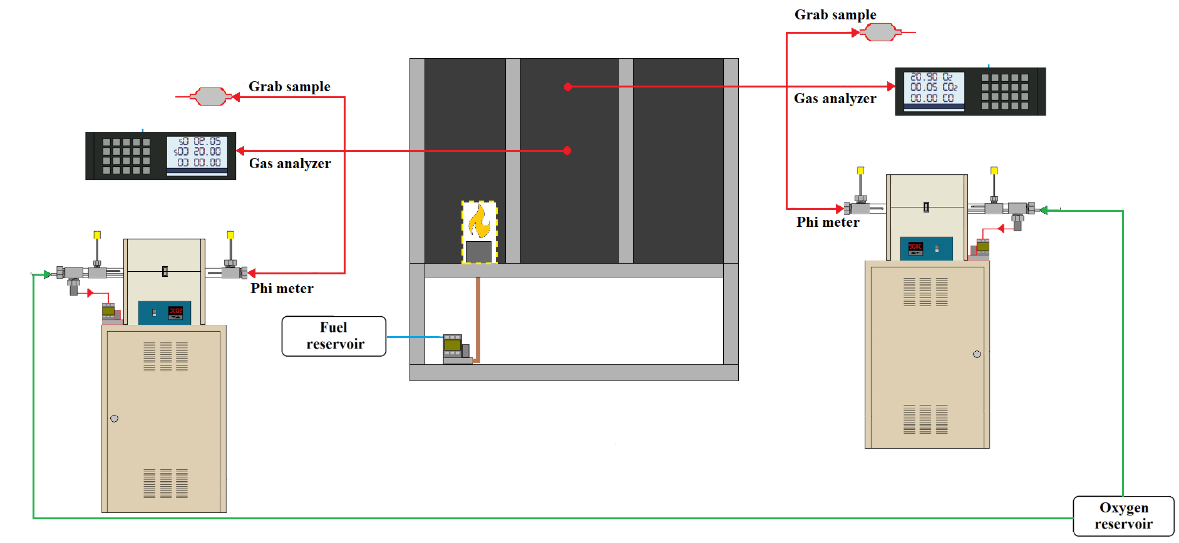
Gas extraction setup
Gas extraction setup for backdraft experiments
Sample Technique | Analysis Method | Purpose
Grab Sample | Gas Chromatograph with thermal conductivity and mass selectivity detectors (GC/MSD)^{[2]} | Verify gas species measurements
Gas Analyzer | Paramagnetic and nondispersive infrared sensors | Measures real-time oxygen, carbon dioxide, and carbon monoxide concentrations
Phi Meter | Lean catalytic combustion of extracted gas sample | Measure real-time equivalence ratios
4

Slide 5



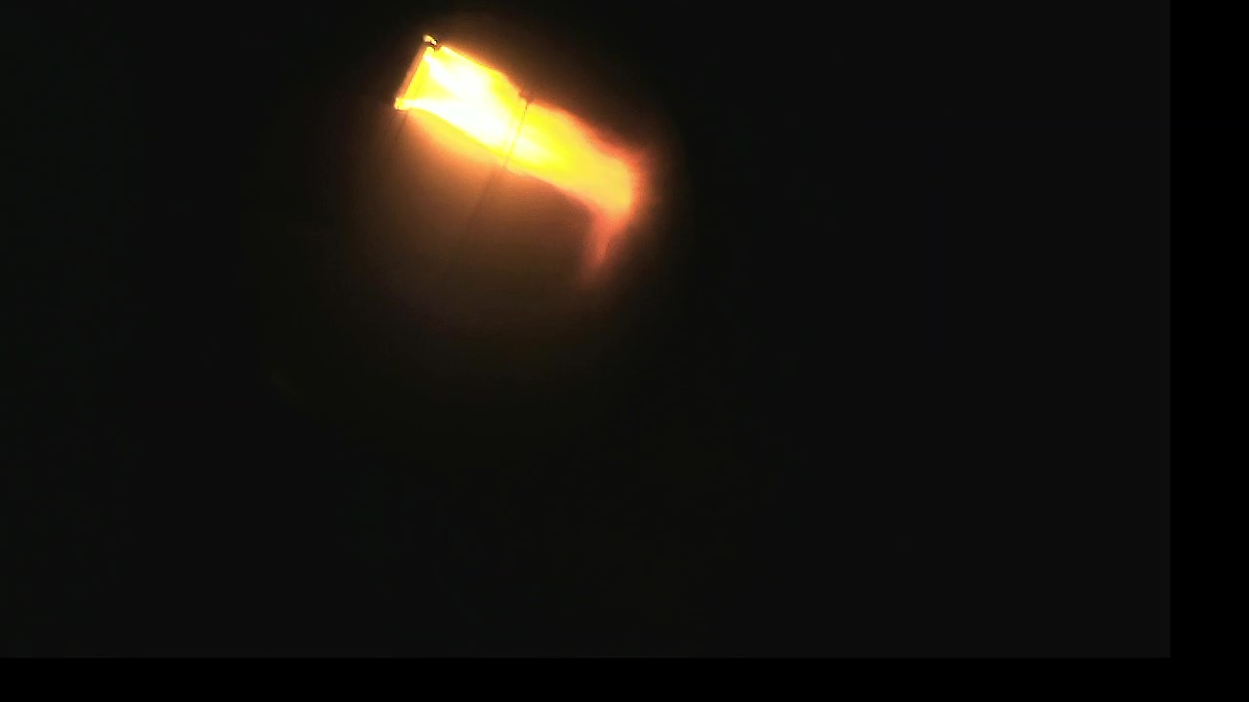
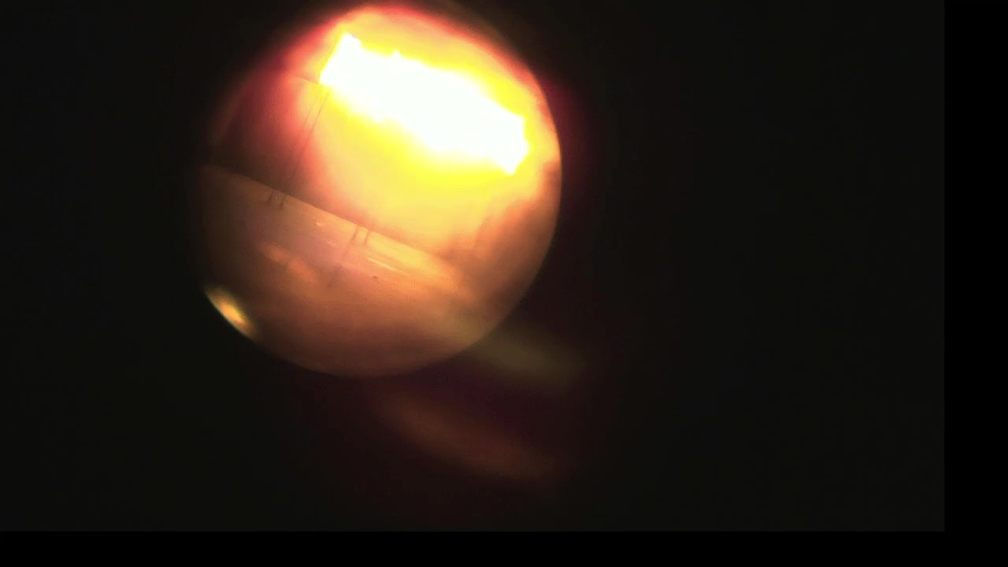

Extinction Timeline
Extinction is defined when the flame is no longer observed in the borescope video
Observed extinction times were consistent for different fuel flow times of the same fire size
Ghost Flame
Extinction
Small flame sheet
with streaking
NOTE: Ghost flame photo is modified to improve visibility
Flame
Diminishing
Burning
Ignition
5

Slide 6
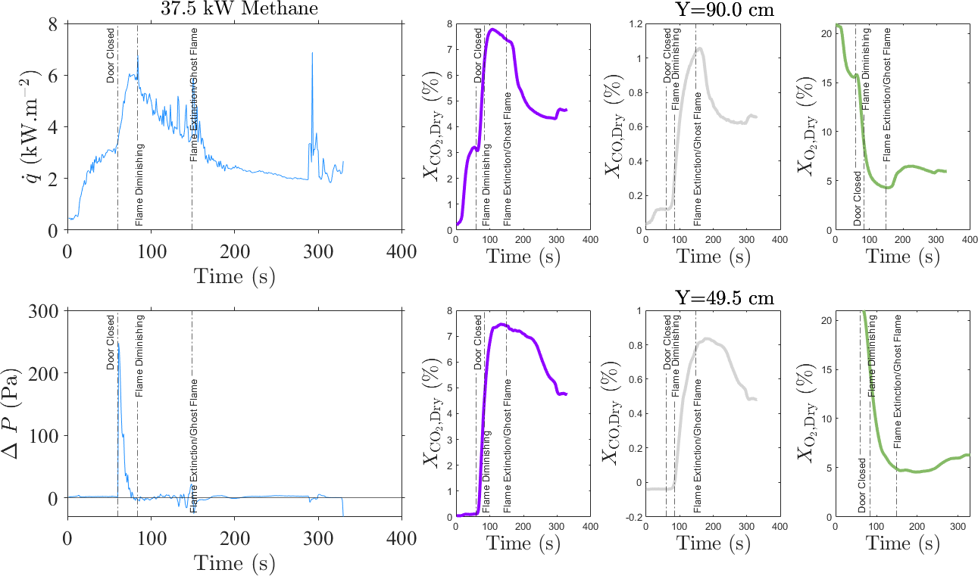
37.5 kW Methane
6

Slide 7
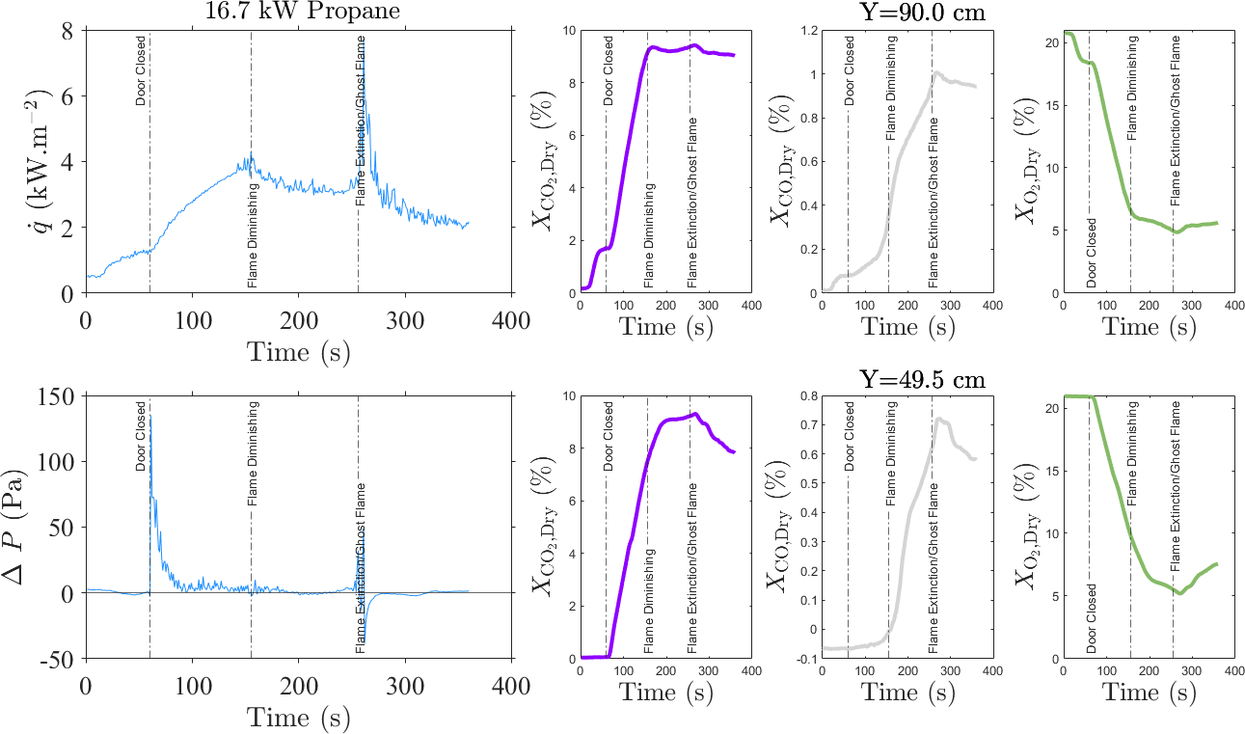
16.7 kW Propane
7

Slide 8
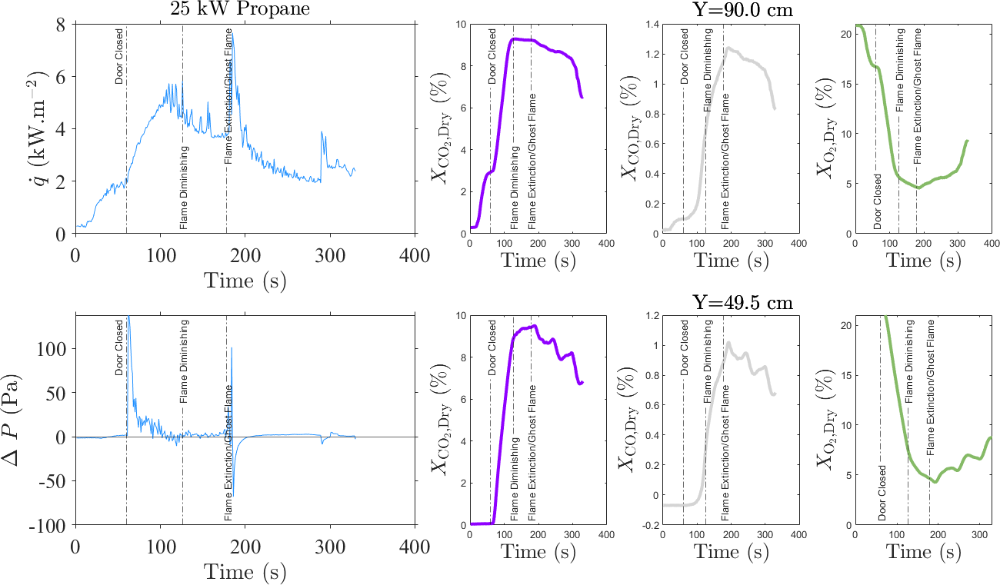
25.0 kW Propane
8

Slide 9
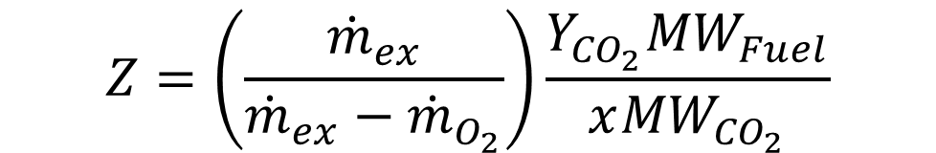
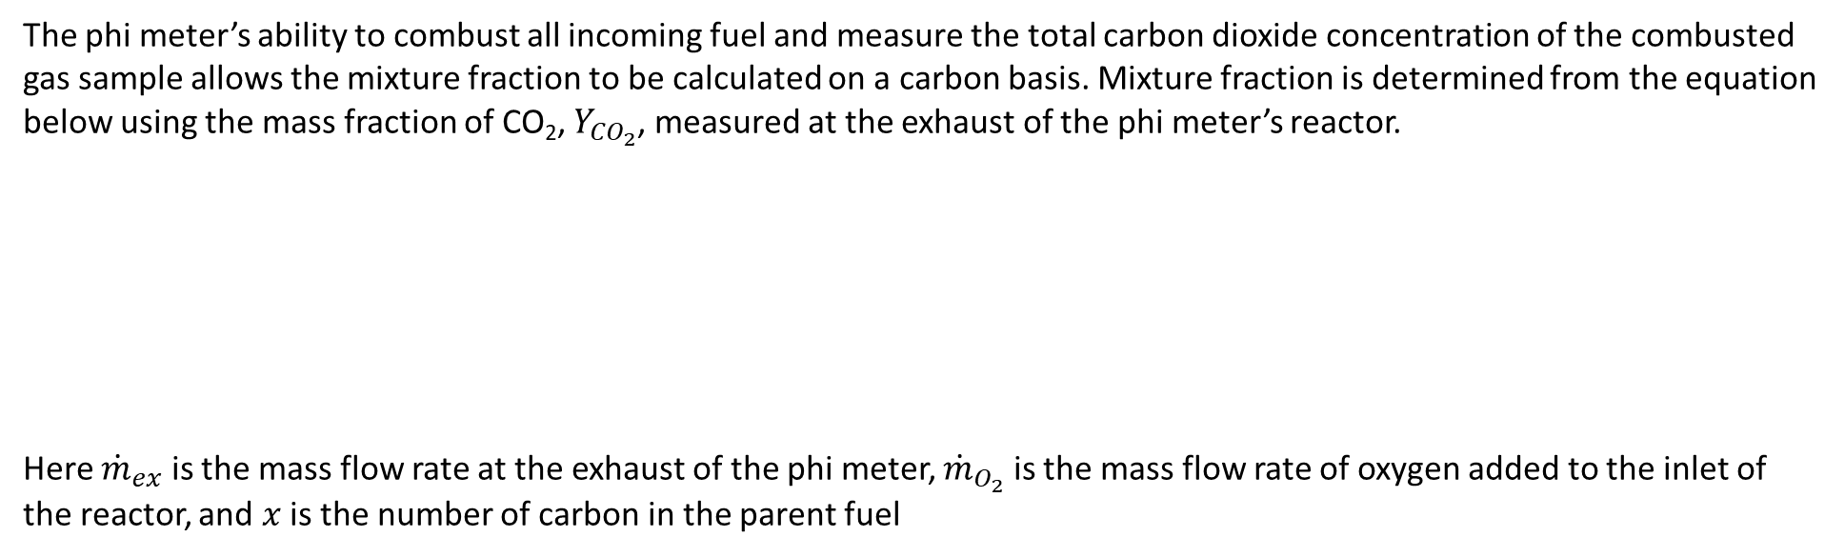
Mixture Fraction Calculation
The phi meter’s ability to combust all incoming fuel and measure the total carbon dioxide concentration of the combusted gas sample allows the mixture fraction to be calculated on a carbon basis. Mixture fraction is determined from the equation below using the mass fraction of CO₂, $Y_{{CO}_{2}}$, measured at the exhaust of the phi meter’s reactor.
Here ${\dot{m}}_{ex}$ is the mass flow rate at the exhaust of the phi meter, ${\dot{m}}_{O_{2}}$ is the mass flow rate of oxygen added to the inlet of the reactor, and $x$ is the number of carbon in the parent fuel
$$Z=\left(\frac{{\dot{m}}_{ex}}{{\dot{m}}_{ex}−{\dot{m}}_{O_{2}}}\right)\frac{Y_{{CO}_{2}}{MW}_{Fuel}}{x{MW}_{{CO}_{2}}}$$
9

Slide 10
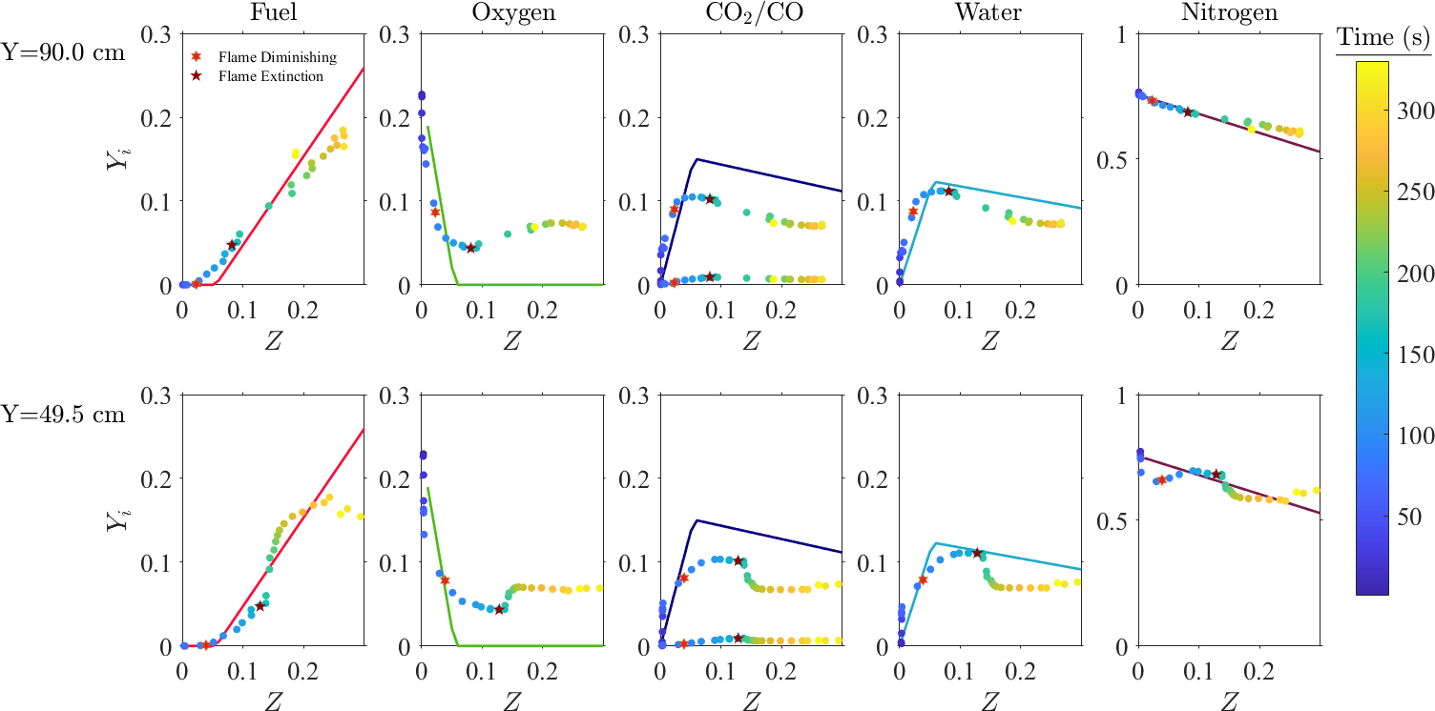
37.5 kW Methane
10

Slide 11
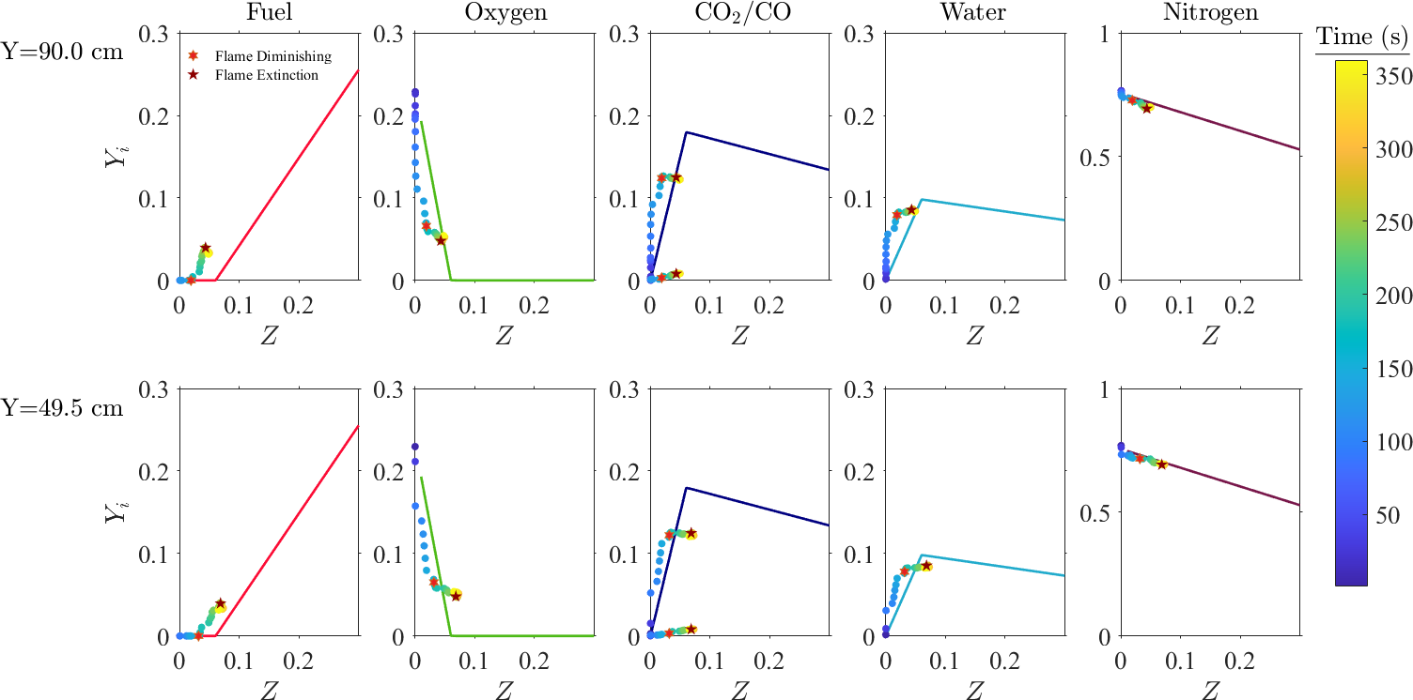
16.7 kW Propane
11

Slide 12

25.0 kW Propane
12

Slide 13
Initial Takeaways
Heat flux locally peaks when the flame diminishes
Heat flux peaks higher when a ghost flame is observed which also create a pressure pulse within the compartment
CO₂ concentrations are observed to peak when the flame begins to diminish
CO concentrations and, inversely O₂ concentrations are observed to peak when the flame is extinguished
Mixture fraction plots show that mass fractions of species, particularly oxygen, break away from the ideal state relation once the flame begins to dimmish.
13

